Slide 1
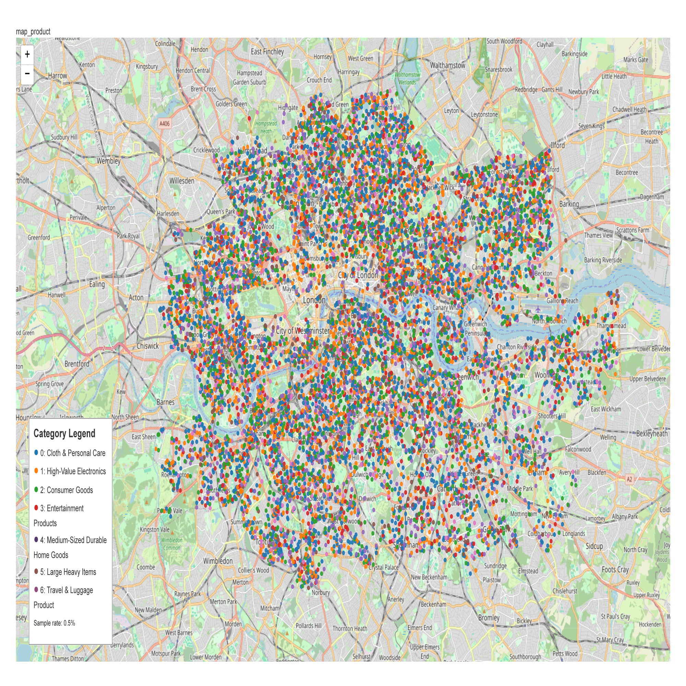
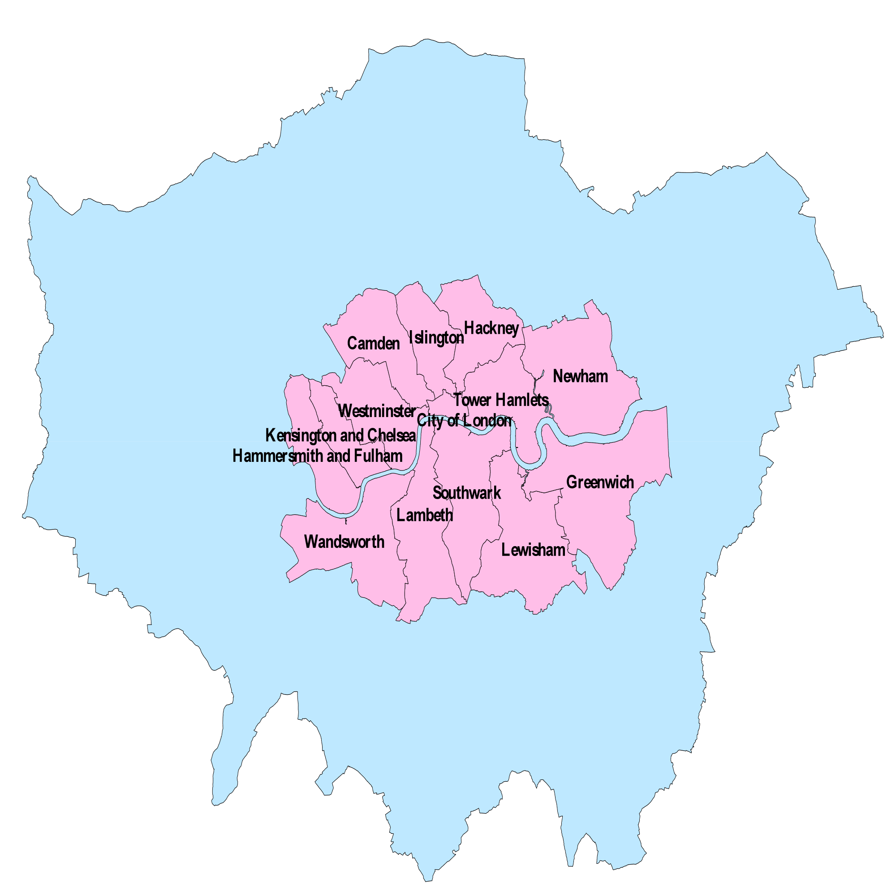

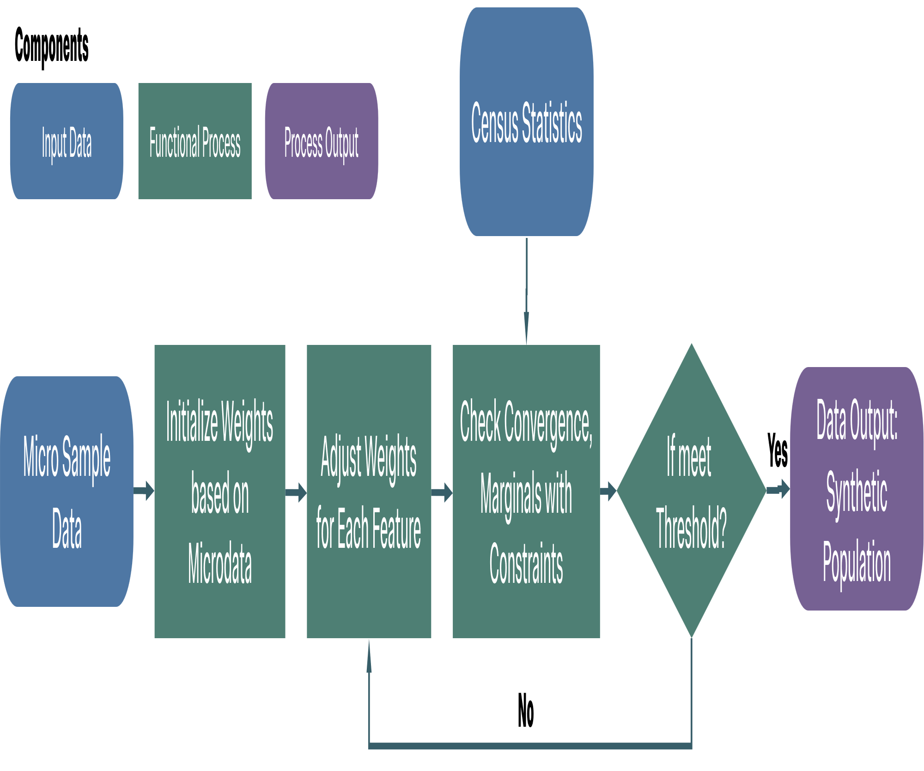
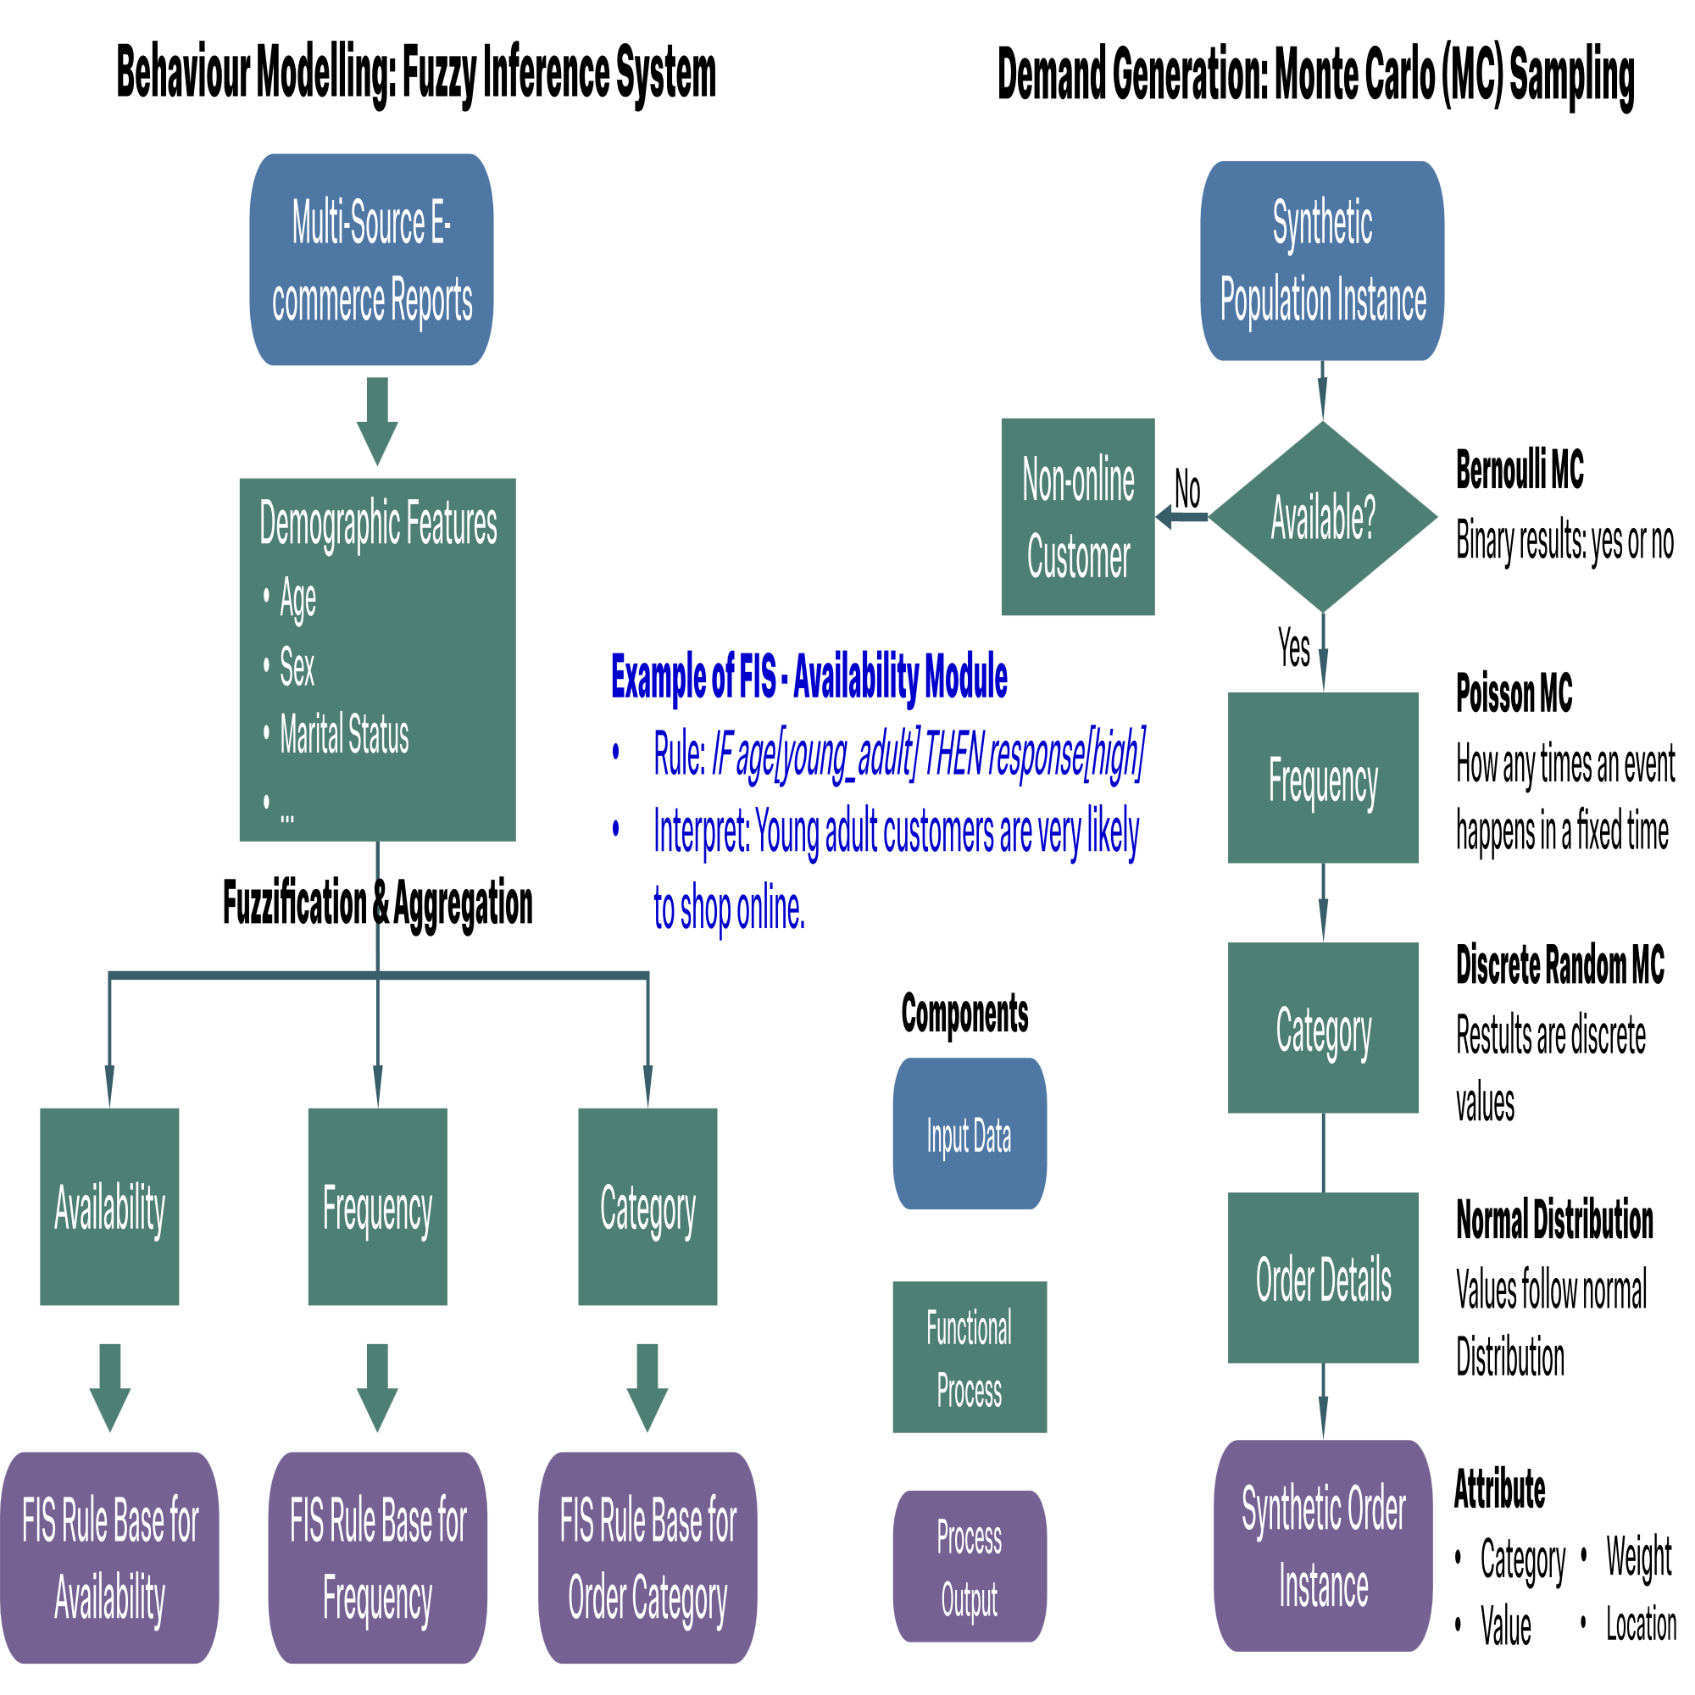
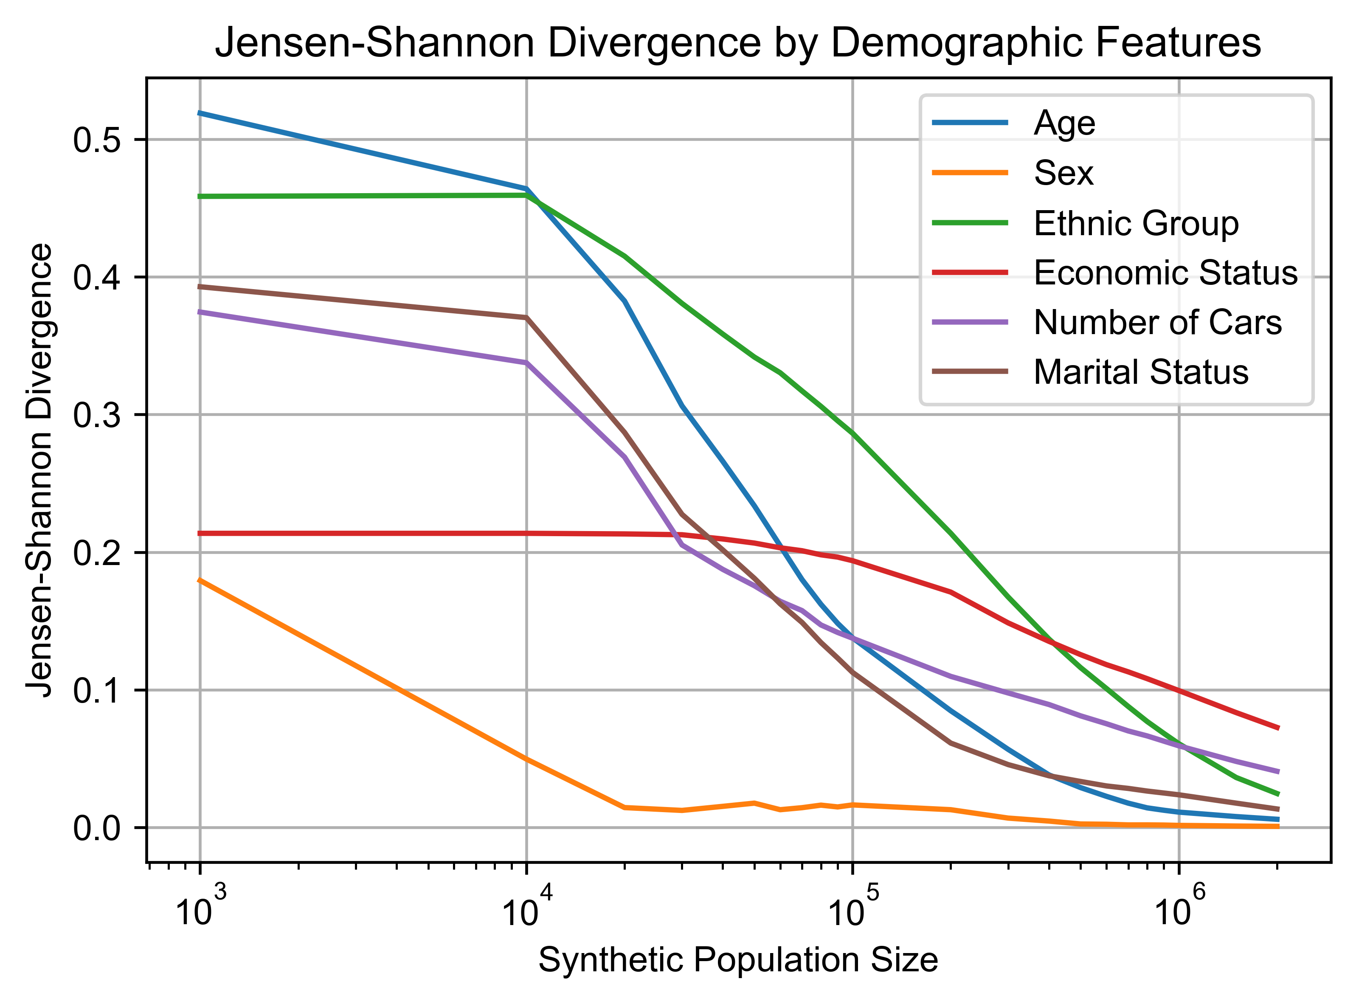
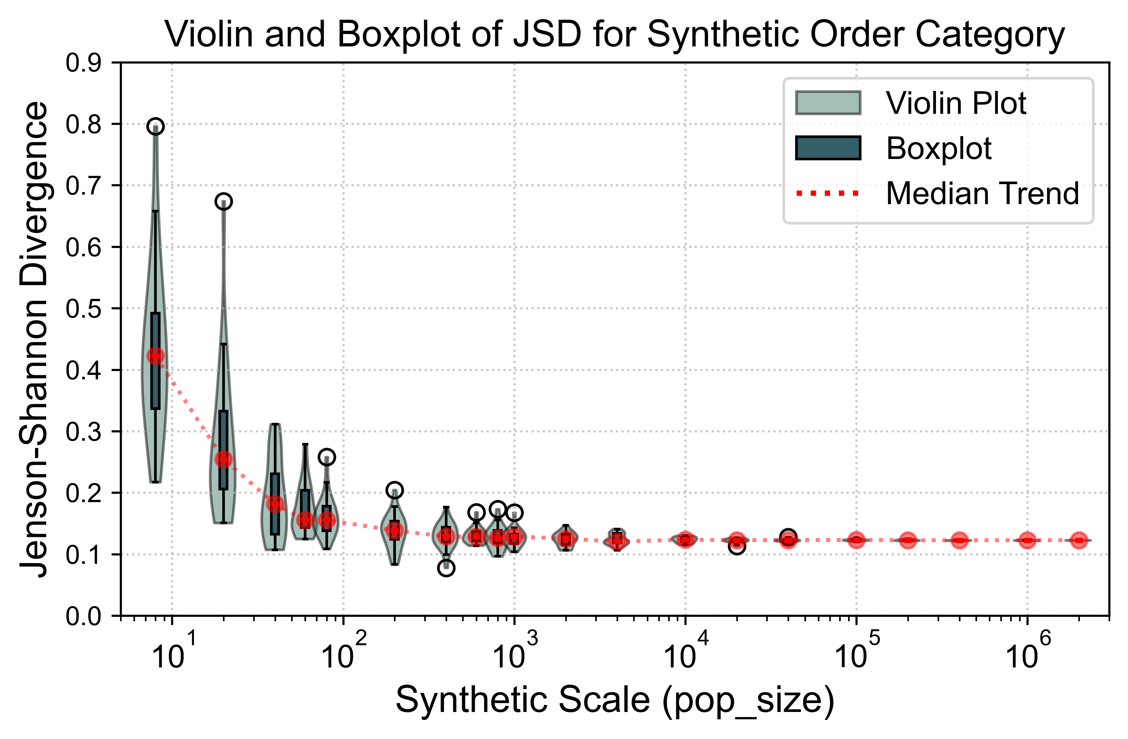
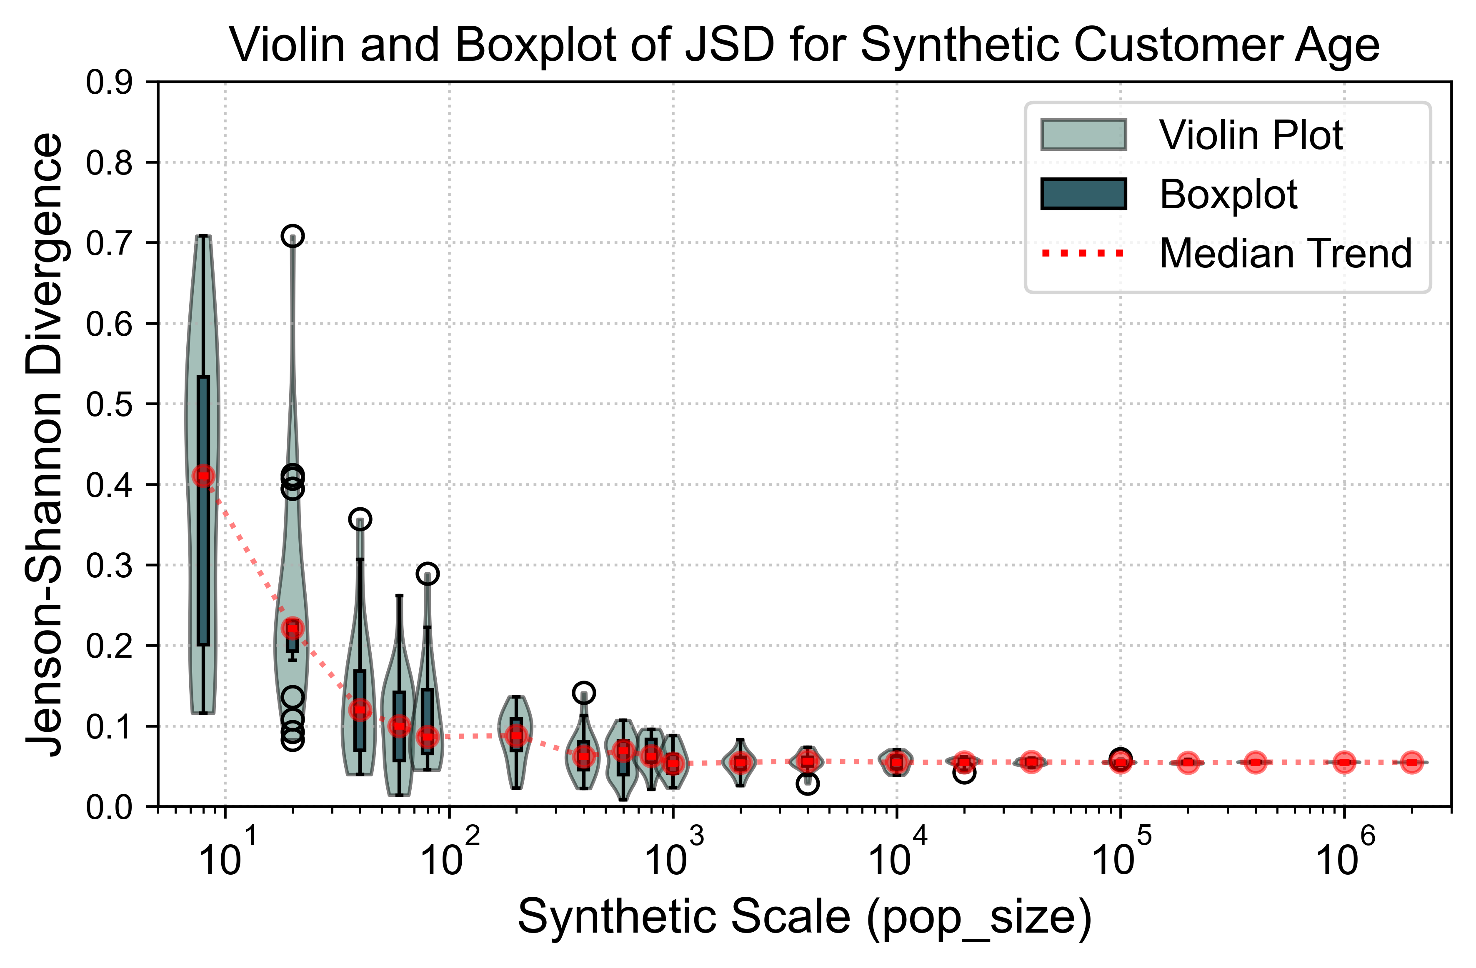
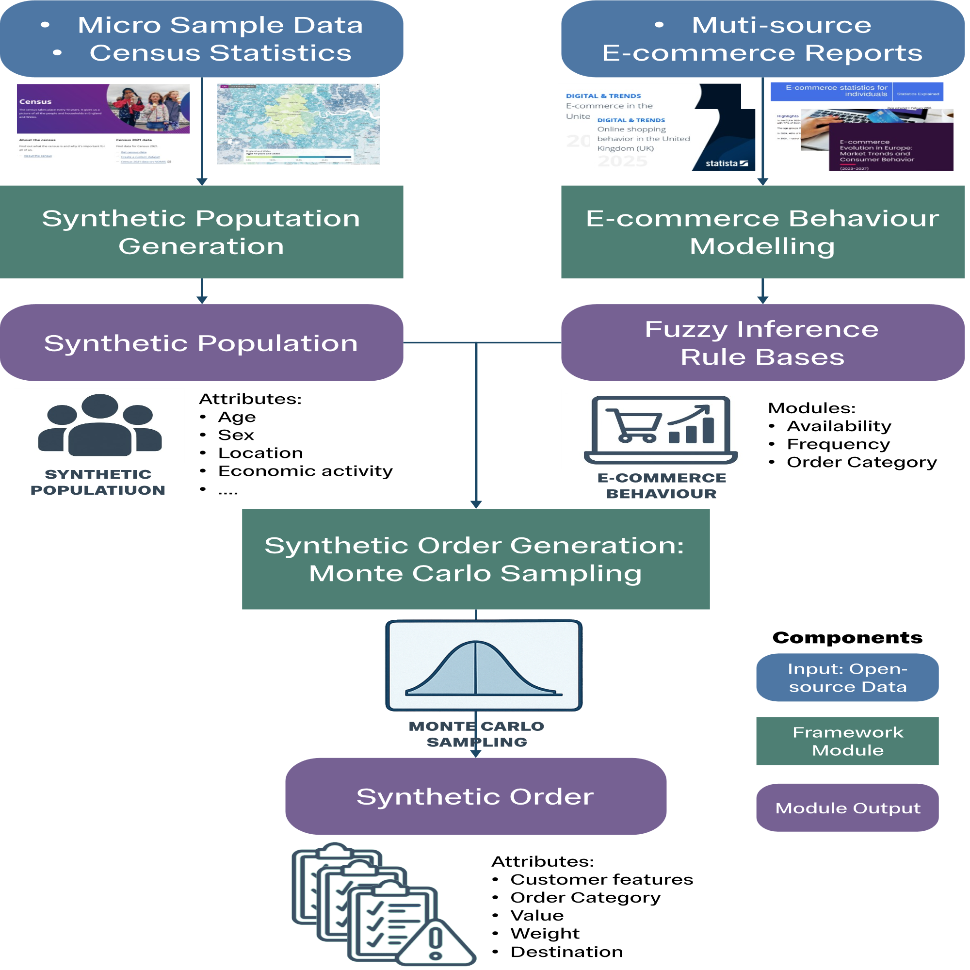
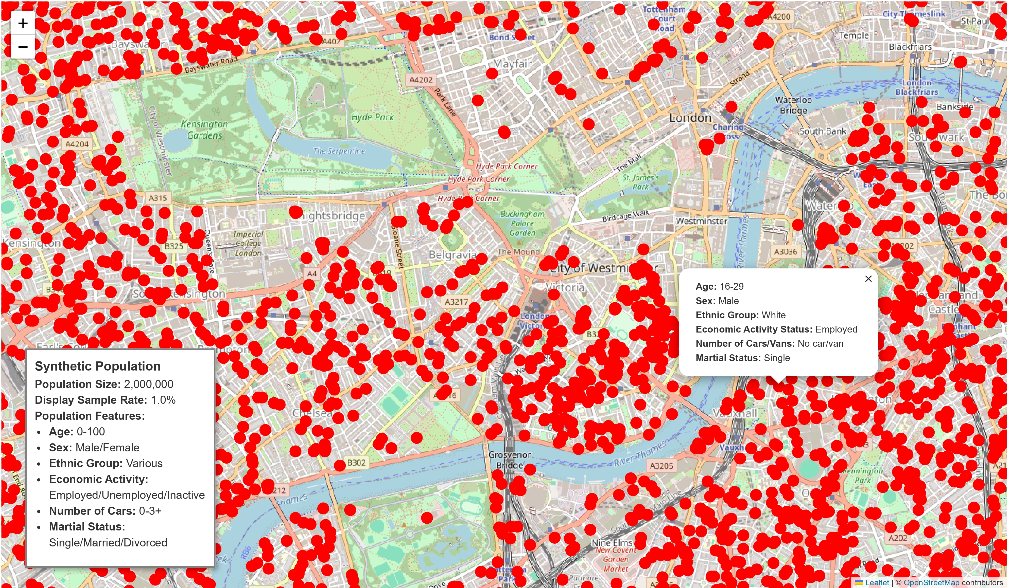
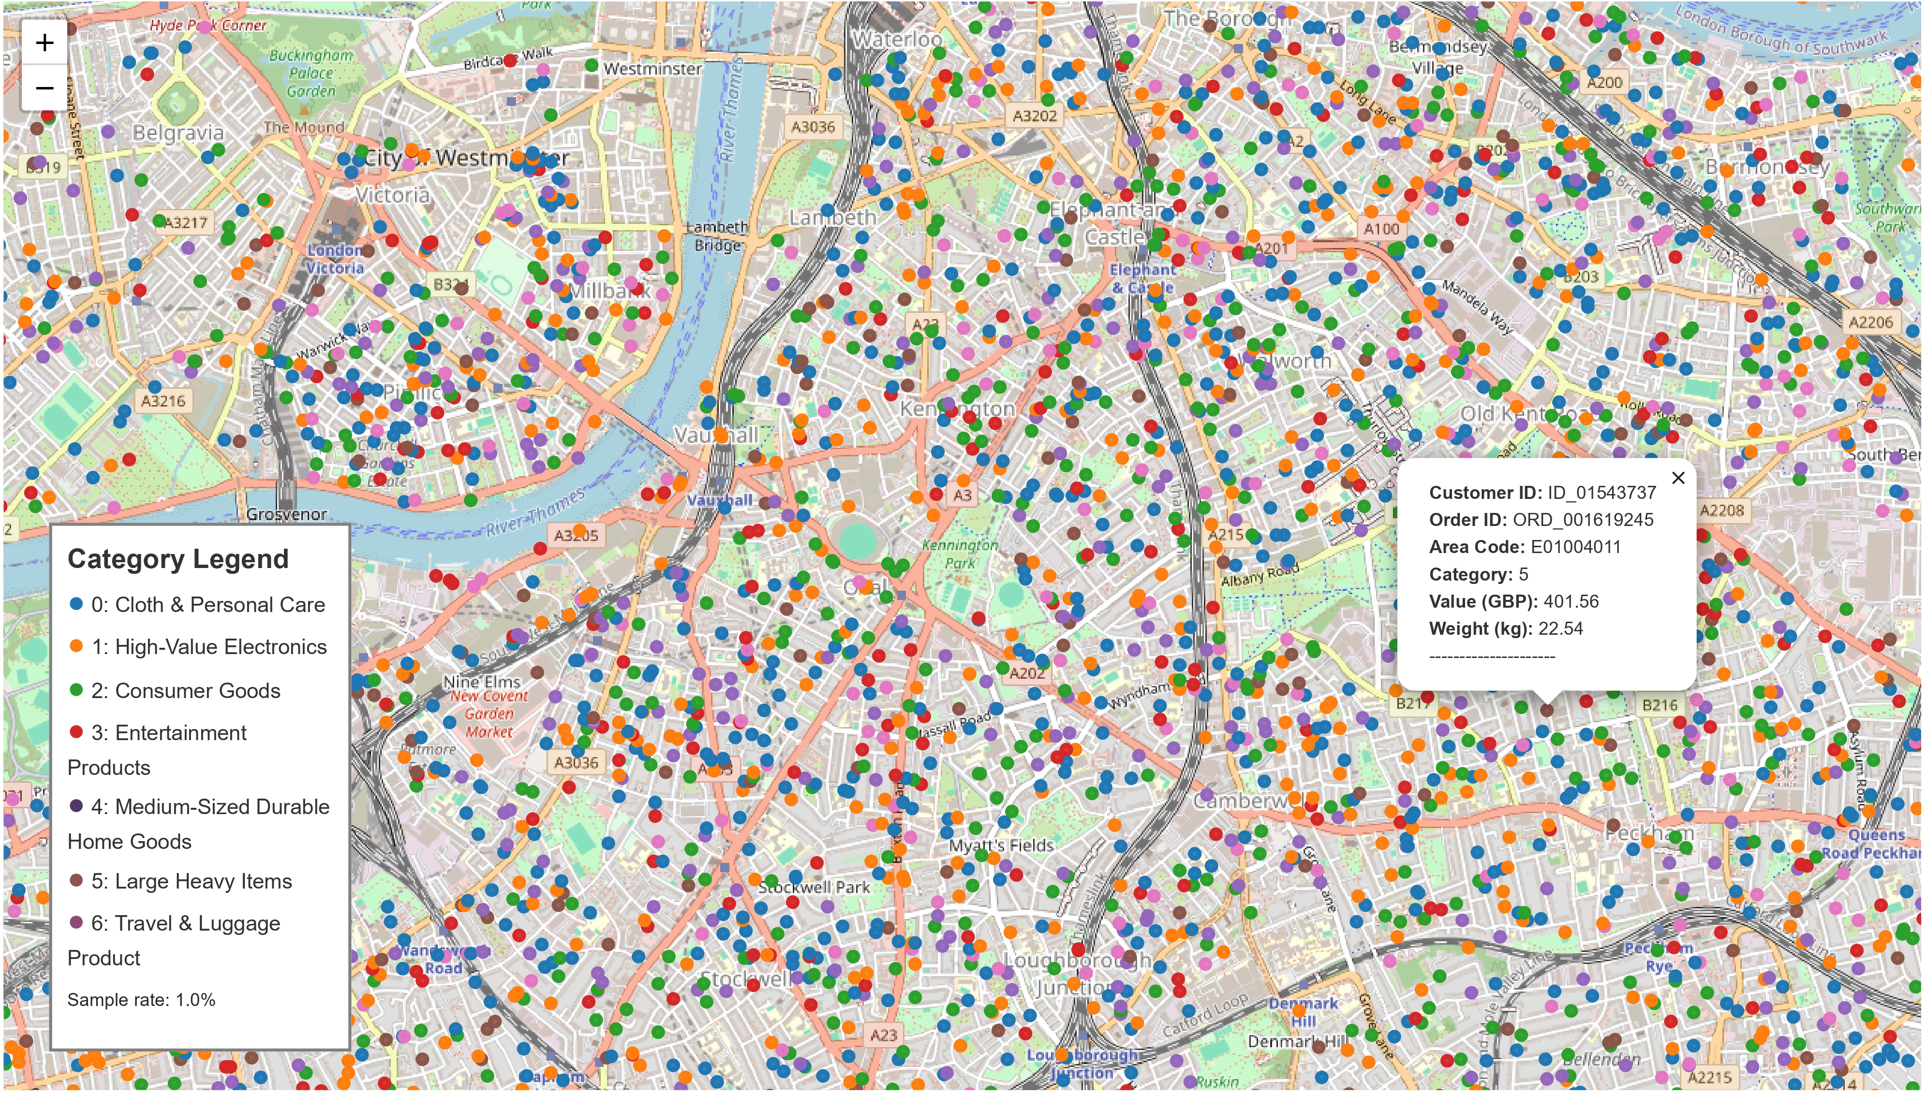

A Data-Efficient Demand Generation Framework for Multi-Agent Last-Mile Delivery via Fuzzy Logic
Yixuan Li
CID: 06013045
Supervisor: Prof Panagiotis Angeloudis
Abstract
With the rapid rise of e-commerce, last-mile logistics face growing demands for efficiency and sustainability. To support delivery optimization, demand-driven simulation is essential, yet existing demand-generation methods often rely on proprietary, opaque, and non-scalable data. This study introduces a population-based framework for synthetic order generation. A synthetic population is constructed from open datasets, while e-commerce purchasing behavior is modeled via fuzzy inference informed by industry reports. Orders are generated using Monte Carlo sampling, and validated through Jensen–Shannon Divergence against real-world data. A case study in Inner London shows that as population scale grows, synthetic orders better align with national purchasing patterns, confirming the model’s validity. The framework offers scalability, interpretability, and reproducibility, providing a practical foundation for future last-mile delivery simulation and optimization.
Highlight
Study Area & Data
Methodology
Inner London Area
Synthetic Population
Figure 4 Flowchart of Iterative Proportional Fitting
This study proposes a demographic-based, validated synthetic order generation framework and demonstrates its value for last-mile delivery simulation.
Figure 2 Study Area
Figure 3 Data Granularity: LSOA
Iterative Proportional Fitting
Data
Synthetic Order
Background
All data sources used are open-source data.
Last-Mile Delivery Simulation
E-commerce growth causes higher pressure on last-mile delivery
Need for efficient & sustainable logistics
Demand-dreiven logistics simulation to verify the effectiveness of refined stragtegies
Synthetic Population
UK 2021 Census Statistcs
UK 2021 Census Micro-sample data
E-commerce Behaviour Modelling
Research on purchase preference
Reports of E-commerce Industry
Research Gap
Current demand-generation methods are limited:
Reproducibility: Opaque, proprietary data
Transferability: Single-source, non-scalable
Heterogeneity: Missing customer features
Results
Figure 5 Flowchart of Fuzzy Inference System and Monte Carlo Sampling
Validation Result
Indecator: Jenson-Shannon Divergence (JSD)
Measures similarity between synthetic data and real-world statistics, smaller JSD, higher similarity and fidelity.
Research Objective
Design a Demand Generation Framework
Utilize open, transparent data
Easily extend and interpret
Incorporate customer purchase behavior
Project Framework
Figure 6 JSD by Demographic Features
Figure 7 JSD by Order Category
Figure 8 JSD by Customer Age
As the synthetic population size increases, the JSD steadily decreases and stabilizes, confirming that the proposed framework can generate synthetic populations and orders that closely match real-world distributions.
Visualisation
Figure 9 Web-based Synthetic Population Distribution
Figure 10 Web-based Synthetic Order Distribution
Conclusion
This study tackles data privacy and data scarcity in last-mile delivery by proposing a population-feature-based framework for generating synthetic orders. Validation results using JSD show that larger-scale synthetic instances (over 100) better capture consumer preferences, ensuring realistic order volumes for logistics simulations.
The method is open-source, reproducible, and extensible, enabling incorporation of additional demographics and delivery preferences (e.g., time windows, modes) to support
diverse and fine-grained last-mile logistics simulations.
Project Github
Figure 1 Project Framework

